Slide 1
Connections: Using Social Media to Promote Your Nonprofit’s Mission
2013 Community Roundtable
Presented by
The Junior League of Pelham
Thursday, November 7, 2013

Slide 2
Agenda
Time | Topic | Speaker
7:30 – 8:00 | Arrival / Networking
8:00 – 8:05 | Welcome Junior League of Pelham Overview | Tyson Newton Stephens: President, Junior League of Pelham (JLP)
8:05 – 8:10 | Connections: Using Social Media to Promote Your Nonprofit’s Mission | Kathy Ellis: Co-Chair, JLP Community & Public Affairs
8:10 – 8:15 | Burbio demonstration | Julie Roche: Creator, Burbio.com
8:15 - 8:25 | Glowstone Consulting | Lara Hejtmanek: Glowstone Consulting
8:25 – 8:30 | Friends of the Pelham Library - Using Social Media to promote Pelham Reads! | Rich Zahradnik: Friends of the Town of Pelham Public Library
8:30 - 8:35 | PACT - Connecting with teens & parents through social media | Christine Spana: Social Marketing Manager, PACT
8:35 – 8:50 | Group Discussion / Feedback | All
8:50 – 8:55 | Grants Information | Aisling Bier: Grants Coordinator, JLP Community & Public Affairs
8:55 – 9:00 | Closing

Slide 3
Junior League of Pelham Overview
The Junior League of Pelham is an organization of women committed to
the improvement of Pelham and its surrounding communities
Mission
Promote volunteerism
Develop the potential of women
Improve the community
Focus Areas
Education
Pelham Library Partners promotes early literacy through a twice-weekly children’s story time at the Pelham Public Library
Teen Improvisation Nights invites teens to attend improvisation classes and perform for their peers; providing safe, fun, substance-free activities for teens on weekends
Healthy Families
Food Rescue Run with County Harvest JLP members participate in food rescue from restaurants, grocery stores, and hotels to homeless shelters in Westchester County
Backpack Program provides weekend food provisions for children in need
Pelham Improvement
Martha Emmons Weihman Memorial Park
Beginning stages of a new campaign to support park improvement on Wolf’s Lane

Slide 4
Connections: Using Social Media to Promote Your Nonprofit’s Mission
Social media is constantly evolving, yet has become a key component in staying actively connected to the community
Who is your target audience?
Where are they active?
Why are you seeking connections?
Community building?
Awareness?
Fundraising?
What is the outcome you hope to achieve?
How will you:
Measure success?
Maintain relationships?
Control your message?
Interact with your audience?

Slide 5
Burbio.com

Slide 6
USING SOCIAL MEDIA TO PROMOTE YOUR NONPROFIT’S MISSION
LOUISE KELLY
LOUISE@GLOWSTONECONSULTING.COM
LARA HEJTMANEK
LARA@GLOWSTONECONSULTING.COM

Slide 7
TAKEAWAYS
Be strategic
Be engaged
Be yourself!

Slide 8
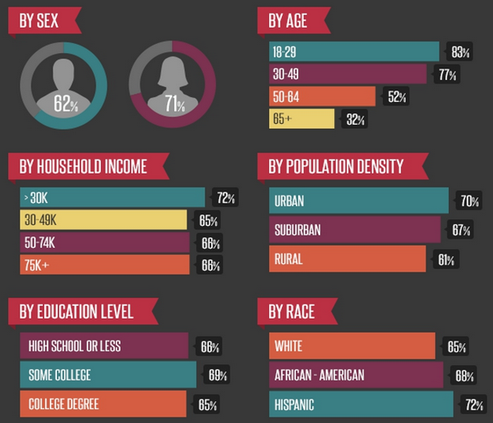
YOU DON’T *HAVE* TO DO IT, BUT IF YOU DO CONSIDER:
Audience
Purpose
Value Exchange
Pew Internet, The Demographics of Social Media Users — 2012

Slide 9
YOU DON’T *HAVE* TO DO IT, BUT IF YOU DO CONSIDER:
Audience
Purpose
Value Exchange
Know your goals
Soliciting individual gifts & donations (most common)
Community building
Reach new audiences
SEO / site traffic
Event focus
Education
Inspiring advocacy
…. combo of the above

Slide 10
YOU DON’T *HAVE* TO DO IT, BUT IF YOU DO CONSIDER:
Audience
Purpose
Value Exchange
What’s in it for me?
Key reasons that people give online:
Personal resonance
They get something tangible
Social influence

Slide 11
WHICH PLATFORMS?
PLATFORM (ranked by users) | DEMOGRAPHIC | SUITABLE CONTENT
1. | Diverse ages, dominates other SN for older users (30-50); wealthy; international | All types of media
2. | Millennials; diverse incomes; urban and ethnically diverse | Short form text, photos, 6 sec videos (Vine)
3. | Male skew; younger and tech savvy | Segment with Circles, long form content; multi-media, hang outs
4. | Business users, male skew | Articles and text
5. | 84% female; older (ages up to 50); wealthy | Photos
http://www.nonprofitquarterly.org/policysocial-context/22969-the-demographics-of-users-of-social-media-summarized.html
http://socialmediatoday.com/stephaniefrasco/1332761/google-plus-overview

Slide 12
HAVE A VOICE; BE AUTHENTIC
Reflect your brand personality
Tone should be casual, approachable
BE HONEST AND TRANSPARENT
Choose the right resource
(probably not an intern)

Slide 13
WAYS TO ENTER THE CONVERSATION
LISTEN – ask questions, run polls
TALK – emote, educate, inspire
RESPOND! – people love it when you reply to them
SHARE – be a content curator
CREATE – make original, shareable content

Slide 14
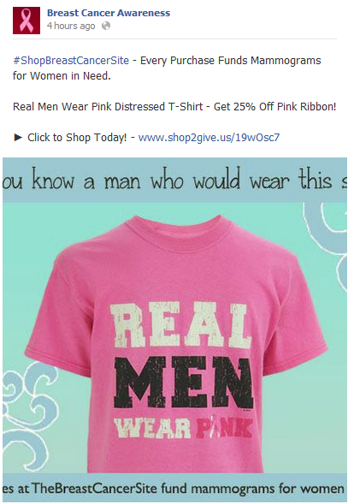
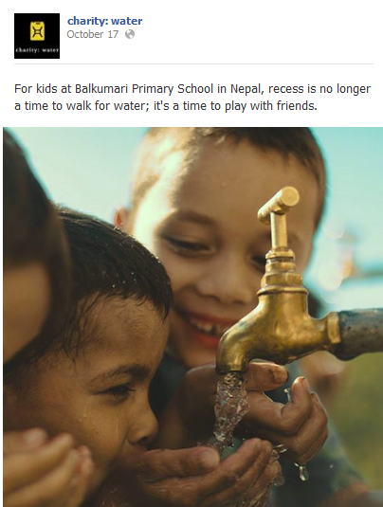
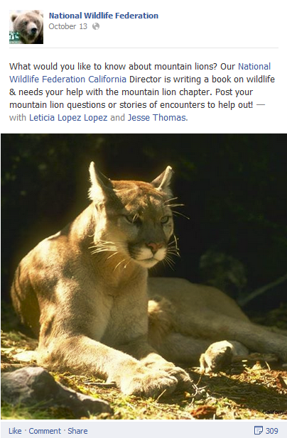
HOW TO ENTER THE CONVERSATION
Strong calls to action
Stories & positive outcomes
Inspiration
Soliciting input

Slide 15
Digital marketing and technology consulting for nonprofits and other worthy causes.
To receive the full version of this presentation, email us:
Louise@GlowstoneConsulting.com
Lara@GlowstoneConsulting.com
www.glowstoneconsulting.com

Slide 16
Pelham Reads! Frankenstein Sponsored by: The Town of Pelham Public Library Friends of the Town of Pelham Public Library The Picture House Pelham Art Center

Slide 17
PACT Coalition
Christine Spana
Social Marketing Manager/
Project Coordinator
pelpactmgr@gmail.com

Slide 18
Mission
PACT is a community coalition encouraging youth to make healthy, safe and substance-free choices.
Target Audience:
Parents/Adult Community Members
Campaigns: Family Time, Talk About It, Resources and Education
Youth
Youth2Youth Events, Internships, Youth Summit, Speakers

Slide 19
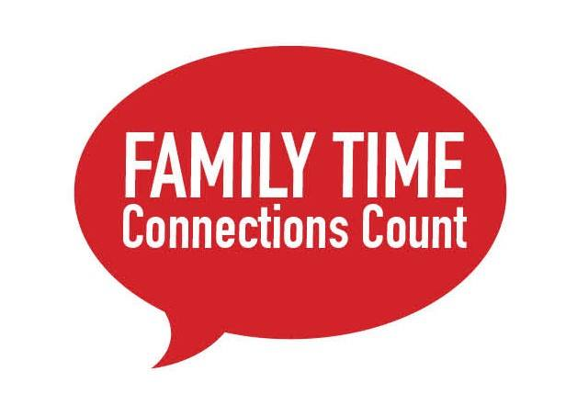
Social Media
Facebook
Connect Pelham parents and community members, Talking tips about drugs and alcohol, Conversation starters, Updates on local events, Links to articles and resources
Website
Information about Coalition, Calendar of events, News articles, Youth Connections, Parent Resources, Drug and Alcohol Facts
Twitter
Tweet events, links to eBlasts
iContact
Newsletters, eBlasts, email lists, surveys

Slide 20
Strategies
Ensure content is current and relevant
Schedule regular posts and updates
Link between platforms
Tie together digital and print marketing
Use eye-catching visuals, phrases
Invite friends
Engage with contests, surveys
Ask questions / provide answers
Have members like, comment, share
Keep conversations going
Review reach
Google analytics, Facebook insights, email reports

Slide 21
Youth Social Media
Summer interns surveyed peers, 98% said preferred method of communication was via facebook
Developed FB profile and Twitter account to promote drug-free events to Pelham teens.
Built website with calendar entries for upcoming events in Pelham, connected with local organizations and newly create youth group
Used humor, art, memes

Slide 22
Help Extend Our Reach
Step 1: Like PACT's Facebook page
Step 2: Share with your friends Like, Comment, Share PACT posts
Step 3: Invite your friends to Like PACT's page

Slide 23
Junior League of Pelham: Grants Overview
The Junior League of Pelham (JLP) makes grants available to community programs and projects in Pelham and surrounding communities that address our focus areas:
Healthy Families
Education
Pelham Improvement
Eligibility Criteria
Decision Process
Eligibility Criteria
The requesting agency must be a tax-exempt, not-for-profit service organization with its base of operations in the JLP service area.
Grant proceeds should ultimately be directed towards improving the lives and health of families, promoting education and/or enriching Pelham or neighboring communities.
Grant requests will be reviewed and approved by the JLP Grants Selection Committee.
Vetted applications will be presented to the JLP Board of Directors for approval.
A lesser grant amount may be offered by the JLP than the amount requested.
Each request will be considered on a one-time basis. No application will be carried over from one JLP fiscal year to the next.
Grant applications must be postmarked or emailed by January 15, 2014.
All applicants will be notified of decisions by March 15, 2014.
Grant applications can be found on the JLP website; www.jlpelham.org
Questions can be directed to publicaffairs@jlpelham.org

